Slide 1
Digital Portfolio
STUDENT NAME: KOWSHIKA A
REGISTER NO AND NMID: 2422J1009 AND F182F342BE3E8769B544B6162F053CD2
DEPARTMENT: BCA
COLLEGE: Akshaya Collage of Arts and Science / Bharathiyar University

Slide 2
PROJECT TITLE
CreativeFolio: A Gradient & Modern Artistic Portfolio

Slide 3


AGENDA
Problem Statement
Project Overview
End Users
Tools and Technologies
Portfolio design and Layout
Features and Functionality
Results and Screenshots
Conclusion
Github Link
3/21/2024 Annual Review

Slide 4

PROBLEM STATEMENT
Most digital portfolios either look too formal or too plain. For creative individuals like designers, developers, or artists, there’s a need for something colorful, vibrant, and modern that reflects creativity. Without such expressive designs, portfolios fail to showcase the personality of the creator.

Slide 5

PROJECT OVERVIEW
The project, CreativeFolio, is a gradient-based modern portfolio website designed with bright colors and artistic layouts. It combines smooth gradients, animated elements, and bold typography to make the portfolio stand out. Built with HTML, CSS, and JavaScript, the site emphasizes style while keeping it user-friendly and responsive.

Slide 6

WHO ARE THE END USERS?
🎓 Students – who want their portfolios to feel more vibrant.
🎨 Designers & Creatives – to showcase creative projects in a modern way.
👨‍💻 Developers – highlighting coding projects with artistic presentation.
💼 Job Seekers – making resumes more eye-catching and memorable.

Slide 7

TOOLS AND TECHNIQUES
Frontend: HTML5, CSS3, JavaScript
Editor: Visual Studio Code
Hosting: GitHub Pages / Netlify
Design Style: Color gradients, bold typography, card animations

Slide 8
POTFOLIO DESIGN AND LAYOUT
A colorful gradient header with bold title text
A modern top navigation bar with underline animation
An About section with circular profile + floating text effect
A Projects section with gradient cards and hover lift effect
A Contact section with social media buttons styled with icons
A footer with gradient glow
‹#›

Slide 9
FEATURES AND FUNCTIONALITY
🚀 Dynamic navigation between sections with JavaScript
🎨 Gradient backgrounds and animated transitions
🖱 Hover effects that lift cards and highlight links
📂 Creative project showcase in colorful card format
📱 Fully responsive design (desktop/mobile friendly)
🔗 Contact section with interactive social media buttons

Slide 10

RESULTS AND SCREENSHOTS
✅ Completed a vibrant portfolio website with gradient design
✅ Smooth navigation and animations across sections
✅ Stylish project cards with gradient hover effects
✅ Fully responsive layout with modern look
✅ Perfect for creative individuals looking to stand out
3/21/2024 Annual Review
‹#›

Slide 11
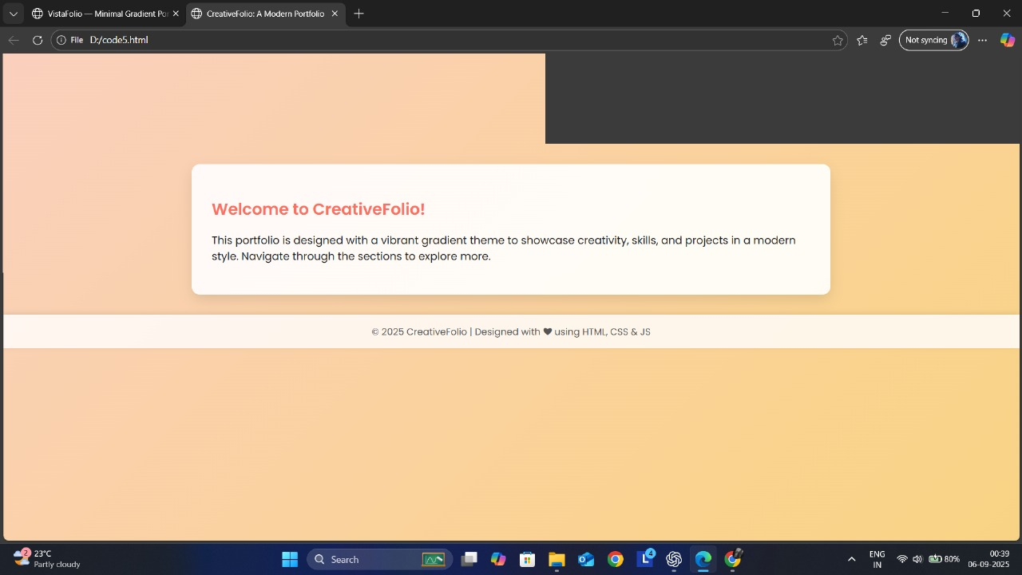

Slide 12
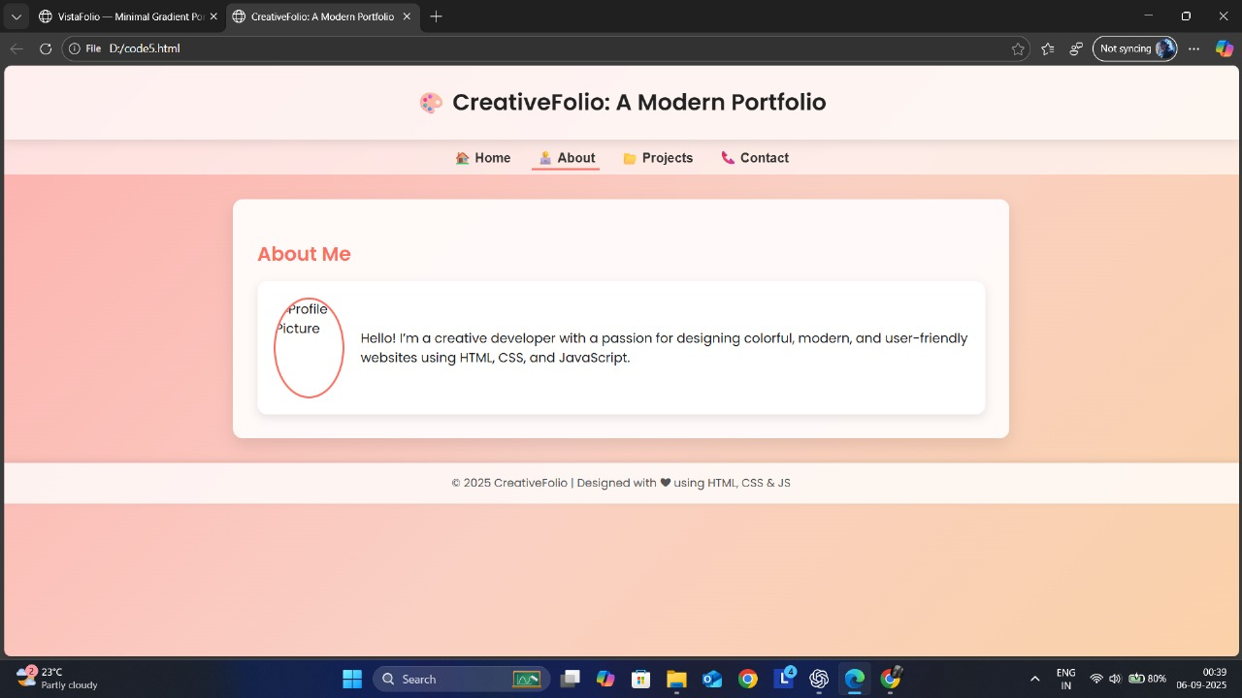

Slide 13
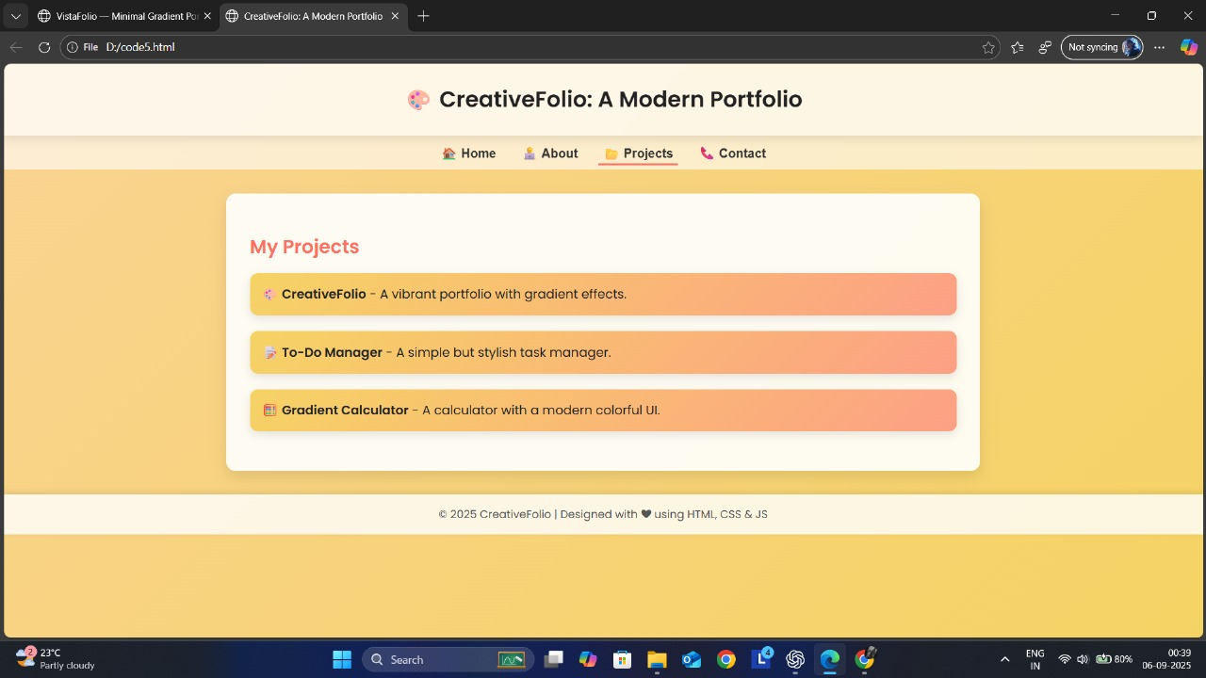

Slide 14
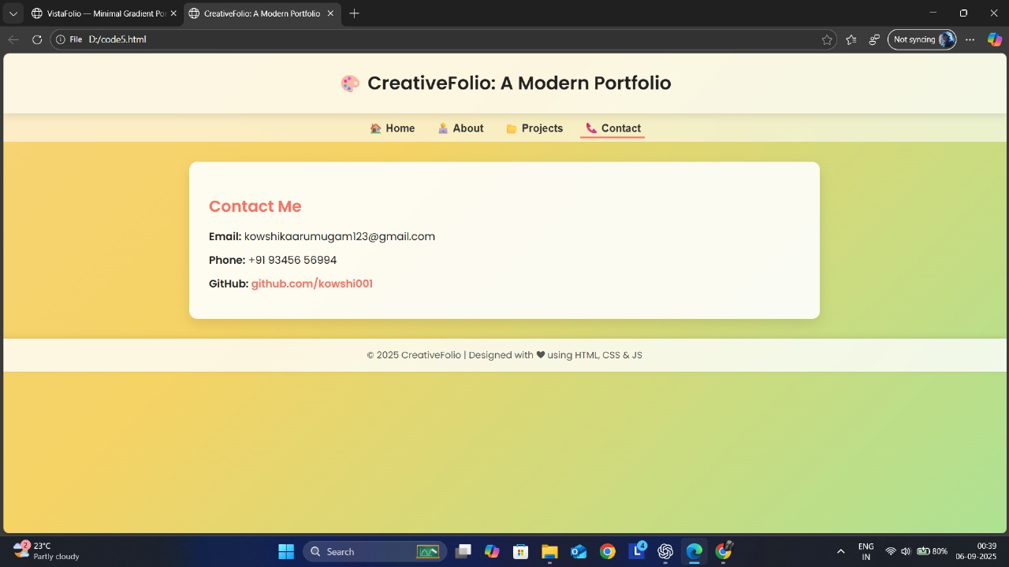

Slide 15
CONCLUSION
The CreativeFolio project offers a modern and vibrant way to present skills and projects. Its bold use of gradients, animations, and colorful design makes it ideal for creatives who want to leave a lasting impression. It proves that portfolios don’t have to be boring — they can be both functional and artistic.
‹#›

